Slide 1


Whitespace Project
WSU Experience
Lazola Cebe
Director Financial Control

Slide 2

PRESENTATION
OUTLINE
Where we started
Student Applications
HR Applications
Academic staff Applications
Finance Applications
AdaptIT Whitespace
Questions

Slide 3
WHERE WE STARTED
At WSU the white space project predates the ITS White Space project
New CFO and new Registrar assessed the ITS system with AdaptIT
Found under utilized vs what was paid for
They arranged trainings and user access to maximise use
Manual processes, limited general controls, compromised results and procurement processes
2019-2020
CFO & Reg Assess ITS Use
2020 - 2021
Improve access
Train on current ITS
2022
Intro online apps
Intro of RYs
2023 – to date
- Online registrations
- Procurement online
- Online staff claims

Slide 4

STUDENT APPLICATIONS

Slide 5
STUDENT APPLICATIONS - ADMISSIONS
WSU had less walk-ins now since going online 3 years ago:
Application
Submission online
Assessment and approval
Amendments
Add subjects
Cancel subjects
Access to information
Access to timetable
Access academic records
Academic progress
Access to fee statements
Assignments are submitted online – Moodle
Turn-It In used for checking plagiarism
In the pipeline
Alumni Management System – Done
Digitization of Academic Exclusions appeals
Chatbot

Slide 6
STUDENT APPLICATIONS - RESIDENCES
Residence allocations are also done online – students arrive at residence after their registration and confirmed allocations
Billings automatically done on registration
Student iEnabler
Students apply online
ITS
RASA staff accepts/ rejects online
Student iEnabler
Student notified
Only see eligible residences
Apply own choice
Registered on acceptance
Can view registration online
To cancel done online, must be accepted

Slide 7
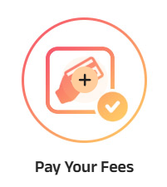
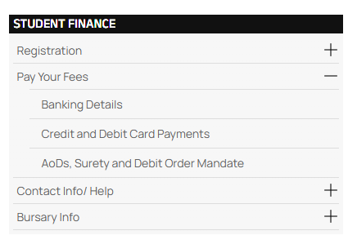
STUDENT SYSTEM – FINANCE
Finance further supplemented automation in the following way:
With the use of Host-to-Host and Paygate payments are cleared on receipt
A student can also apply for their own refunds on iEnabler
Inhouse development of AOD form submission
Online repayment arrangements for fees through debit order mandates
Students interact with Finance digitally through Smax leading to efficiencies

Slide 8

STAFF APPLICATIONS

Slide 9

HR APPLICATIONS
The first department to use iEnabler was HR for capture of leave
Stemmed from audit findings due to loss of manual records
However, during the recent visit showed it is under utilized
In 2024 secondary appointments (part-time claims) moved online.
From 2025 there are no more manual claims and other contracts are moving

Slide 10
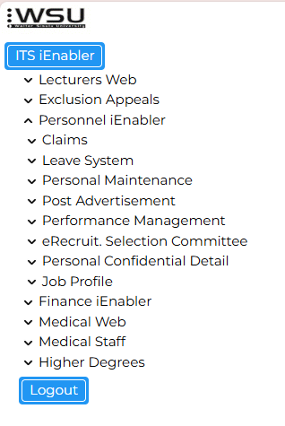

HR APPLICATIONS
Staff make use of Personnel iEnabler for the following:
Submission of claims
Submission of leave
Retrieval of payslips
Retrieval of IRP5s

Slide 11

ACADEMIC STAFF APPLICATIONS
Controls over access to load marks were implemented:
Limited access to relevant staff
Limit in terms of hours and days
Academics now load marks using iEnabler
For assignment submissions Moodle is used
Moodle is also used to communicate assignments/ topics for submission
Once closing date and time reached cannot add more

Slide 12
FINANCE APPLICATIONS
Procurement
Online requisitions - iEnabler
Online budget controls
Creditors
Payment documents on ITS
Managers can see all docs online for reviews
Payroll
Part time claim automation reduces time to capture payment
Third party payments are automated from deductions – thus no missed payments
Online GRV
Automation of delegation of authority
Reconciliations are online
Reconciliations are now automated from 2025
Auto generated remittances
Inhouse development of RFQ and Tender portals have been launched
End-to-end digitization of procurement

Slide 13

FINANCE APPLICATIONS
Debtors
Online invoicing:
Cashbook
Online reconciliations
Funders
Other funding sources

Slide 14


ADAPTIT WHITESPACE
Project benefits to AdaptIT:
Understand future developments required
Why systems are underutilised, to provide guidance
Automation has benefits to WSU:
improving the quality of the data on ITS,
providing accountability to staff
Creating transparency in processes
Creating efficiencies

Slide 15

QUESTIONS

Slide 16

THANK YOU

